Slide 1
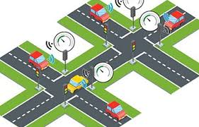
Smart Traffic Control System

Slide 2
Idea/Approach Details Ministry/ Organization name: Problem Statement :Smart intelligent traffic accident monitoring systems (MK104) Team Name : men of genius Team Leader Name : Ujjwal kumar College Code :

Slide 3
Team
Team Leader:-Ujjwal kumar
Team Member:-
Gourav
Aniurdh
Rahul
Monika
Divyanshu

Slide 4
Disadvantage of traffic jam
Waste of Time and Fuel
Air pollution

Slide 5
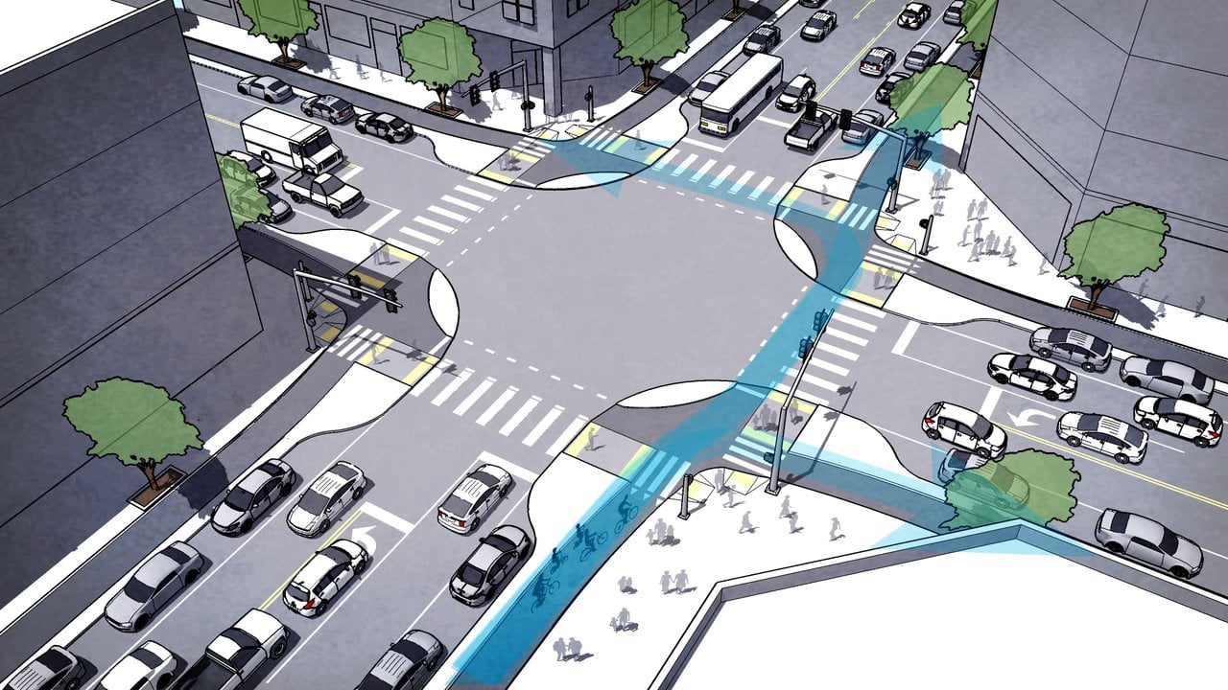
Describe your idea
0
30
1:30
1:00

Slide 6
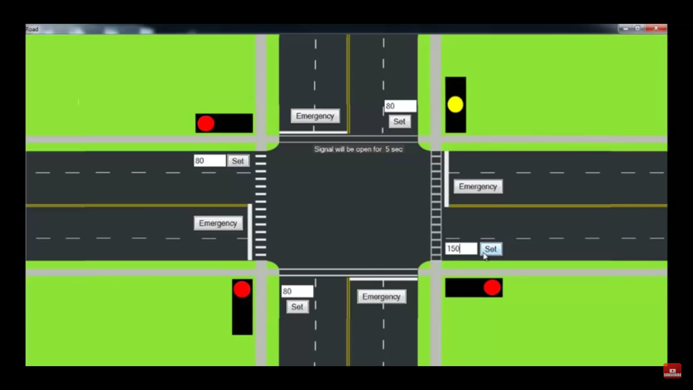
1:30 min
solution
15 car
1:00 min
0 sec
10 car
50 car
15 car
30 sec

Slide 7
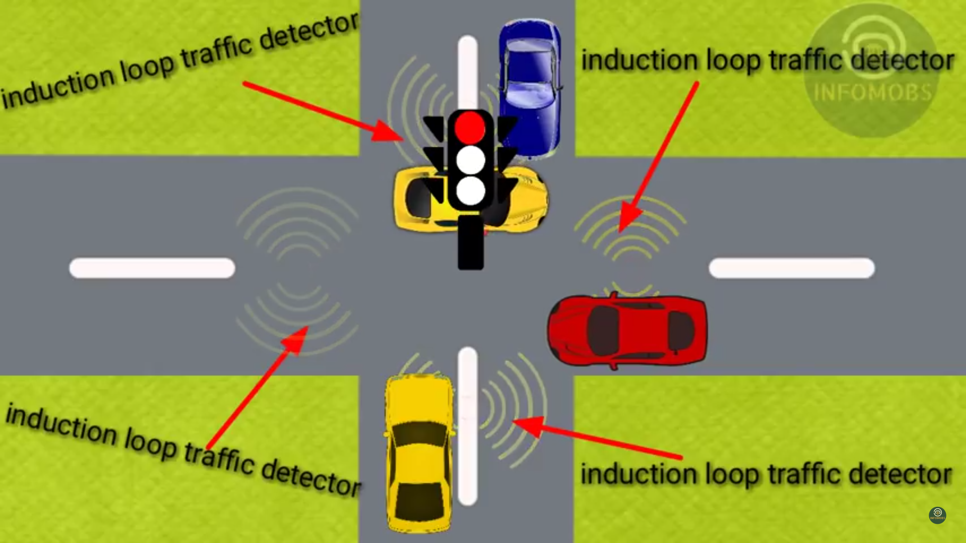
Induction loop are use to
Detect number of car on the road and then control
The traffic signal dynamic
But problem is that
It is very high Cost

Slide 8
Technology and software
Machin Learning
Python(Anaconda)
Opencv(module)
Android app(Android studio)

Slide 9
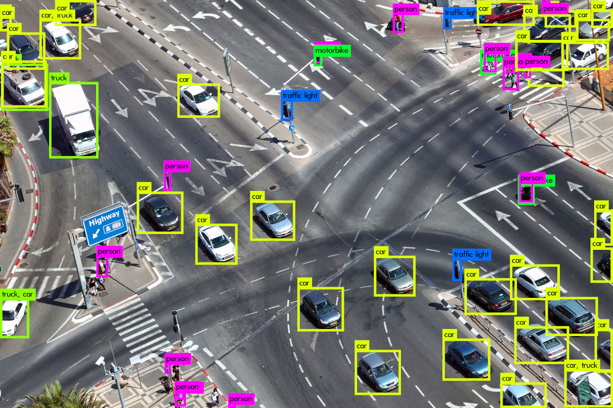

Slide 10
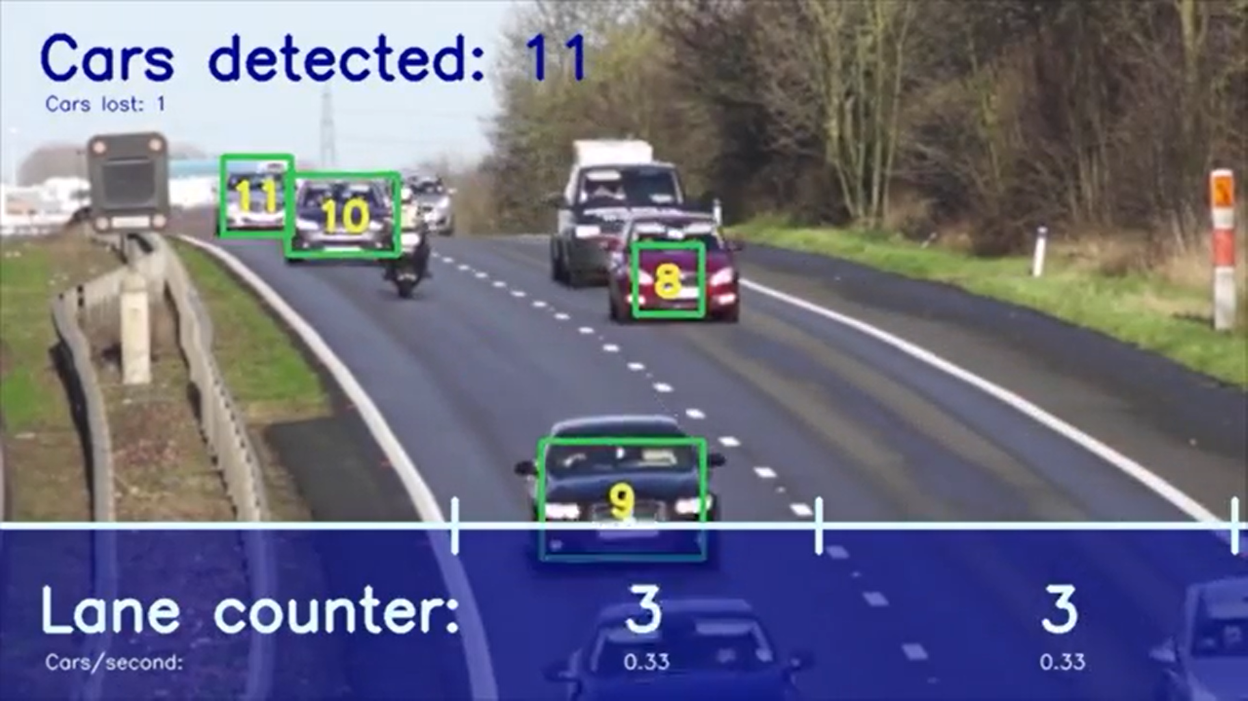
We can not use any sensor or any detector
We are use camera for counting number of car
And then control the traffic signals

Slide 11
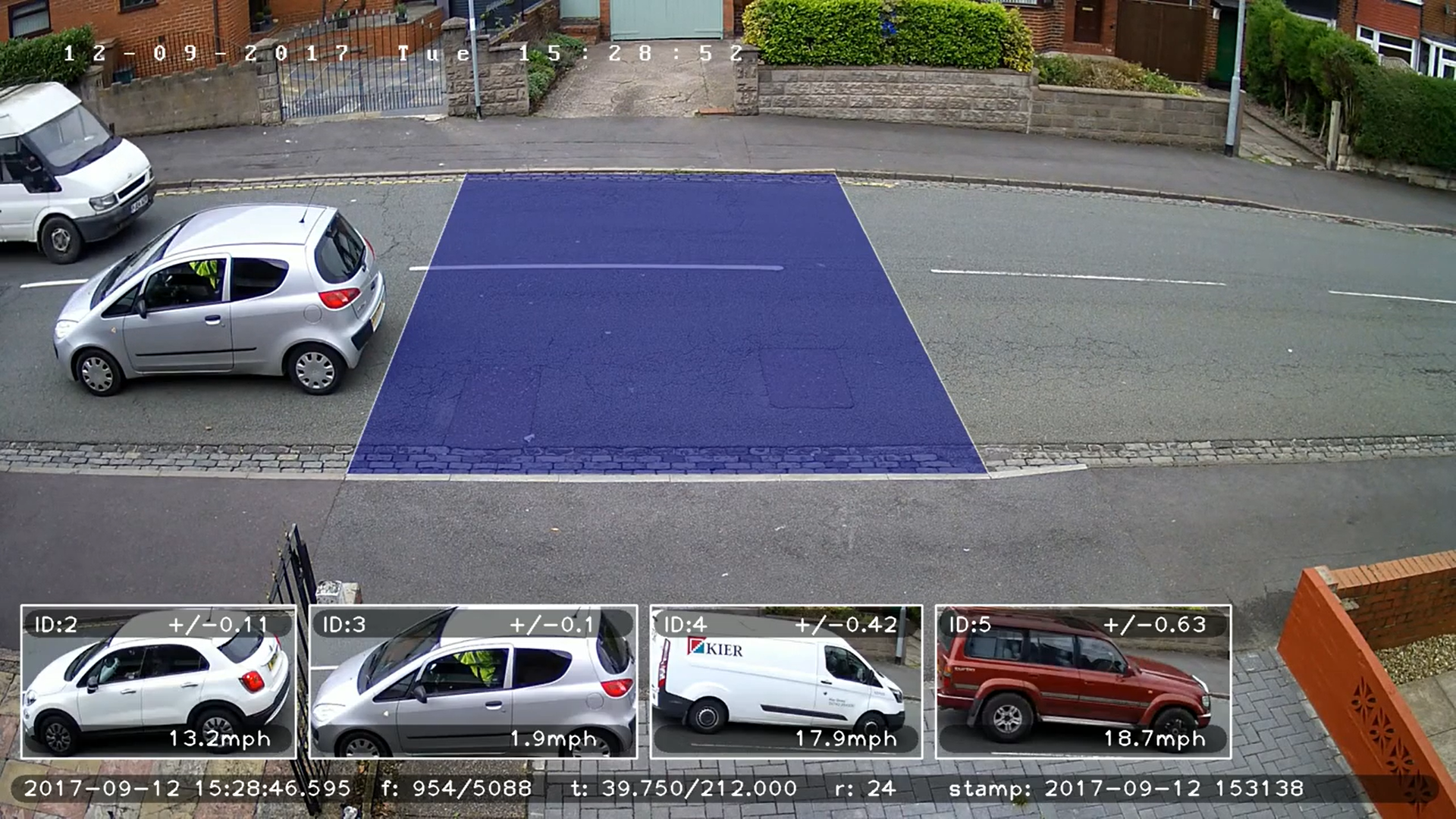

Slide 12
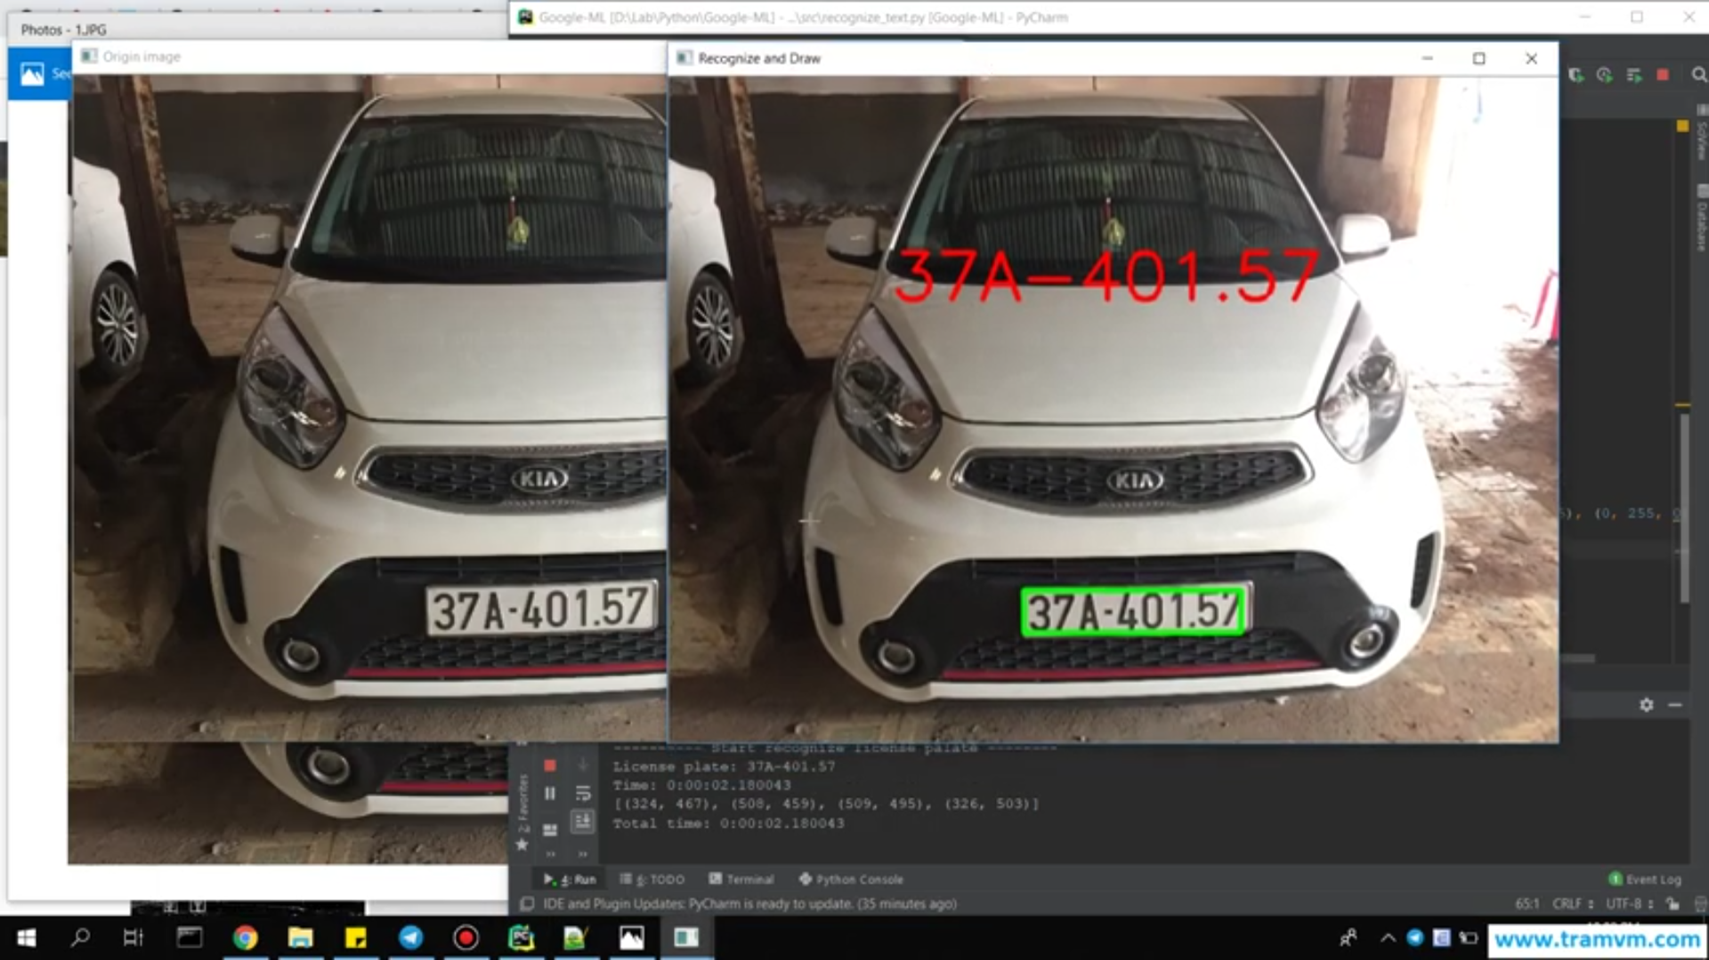
Car Tracking

Slide 13
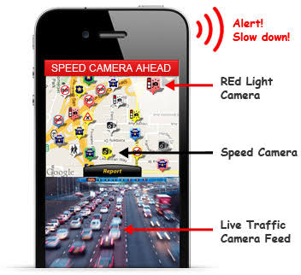
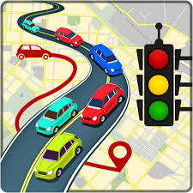

Slide 14

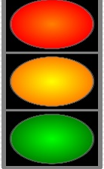
Use Cases

Slide 15
Advantage(purpose)
Save lot of time
Reduce Accident
Dynamic time controller
Prediction of traffic jam
Control traffic jam
Car Tracking
Air pollution
fuel

Slide 16


